Slide 1
Do Now
What do all living things have in common?
What is homeostasis?
What is a control group?

Slide 2
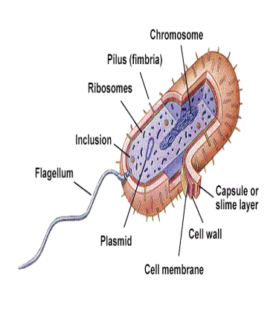
III. Why am I not a fungus?
A. Kingdom Bacteria
1. Cellular Structure: Prokaryotic with cell wall, unicellular
2. Metabolism:
a. Food getting: Very diverse – some are photosynthetic, some are chemosynthetic and some are heterotrophic, taking in food by active transport.
b. Cellular energy: Some are aerobic for the production of ATP, some are anaerobic.

Slide 3
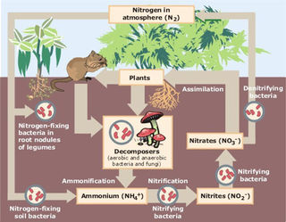
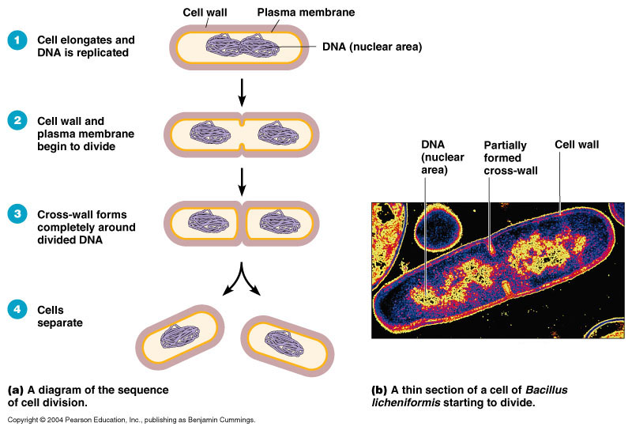
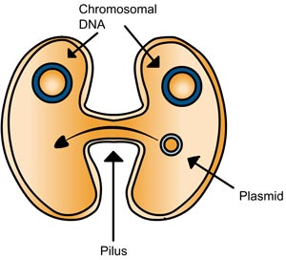
WARNING- X-Rated Image of Bacteria Sexually Reproducing
3. Reproduction: Mostly asexual through binary fission; may exchange DNA using a process called conjugation.
4. Ecological/Economic Importance: Bacteria are important to the environment because they drive the nitrogen cycle and are decomposers. Bacteria can be beneficial to humans (ex. useful in making foods such as yogurt) or harmful (ex. some may cause disease such as syphilis)

Slide 4
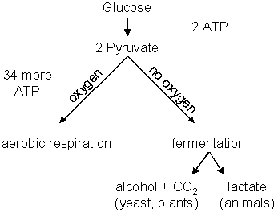
B. Kingdom Archaea (Extreme bacteria!)
1. Cellular Structure: Prokaryotic with cell wall, unicellular (different chemicals in cell wall than Kingdom Bacteria)
2. Metabolism:
a.Food getting: Very diverse – some are photosynthetic, some are chemosynthetic and some are heterotrophic, taking in food by active transport.
b. Cellular energy: Some are aerobic for the production of ATP, some are anaerobic.
Aerobic = Oxygen used
Anaerobic = No oxygen used

Slide 5
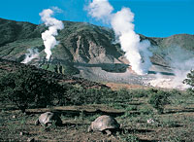
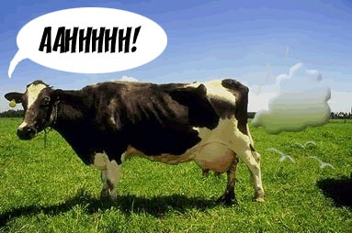
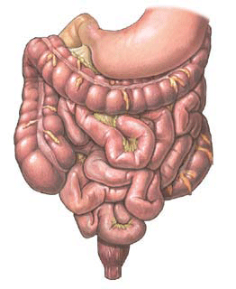
3. Reproduction: Mostly asexual through binary fission; may exchange DNA using a process called conjugation.
4. Distinguishing habitats: They are all classified as “extremophiles” – they live in extreme environments such as thermal vents, swamps, guts of animals, and areas of high salinity.

Slide 6
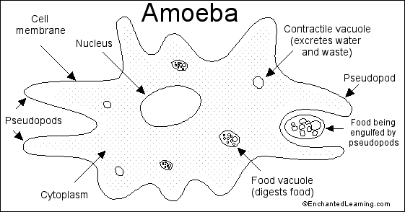
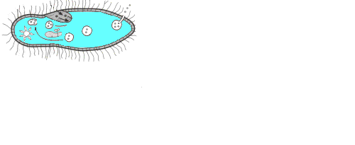
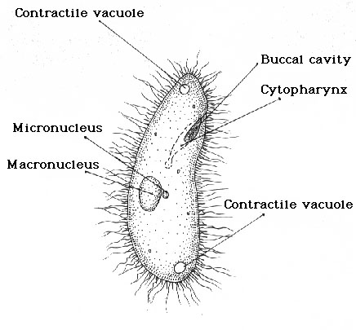
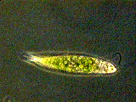
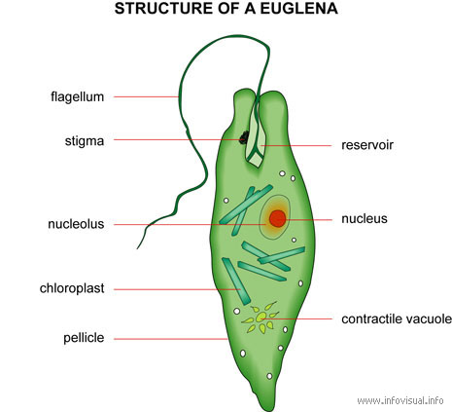
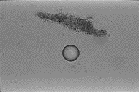
C. Kingdom Protista
1. Cellular Structure: Eukaryotic (some with cell wall and some without), some are unicellular (amoeba) and some are multicellular (seaweed)
2. Metabolism:
a. Food getting: Very diverse – some are photosynthetic (plant-like), and some are heterotrophic (animal-like), taking in food by active transport.
b. Cellular energy: All utilize aerobic respiration for the production of ATP.

Slide 7
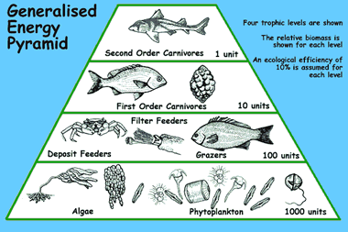
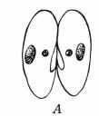
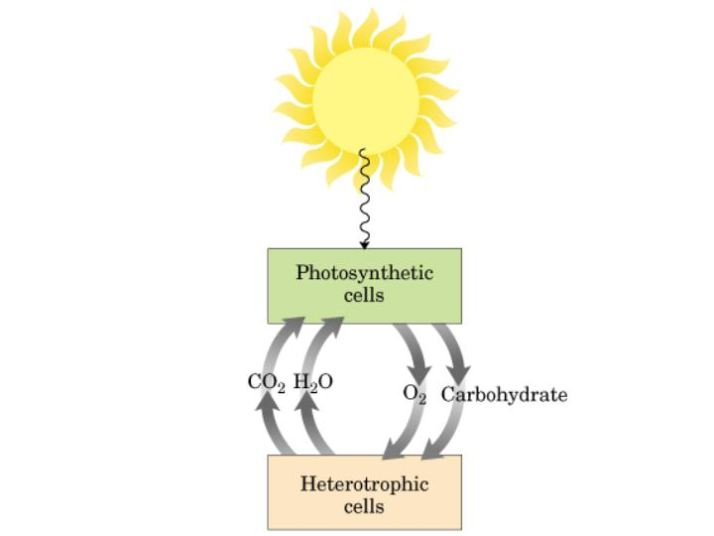
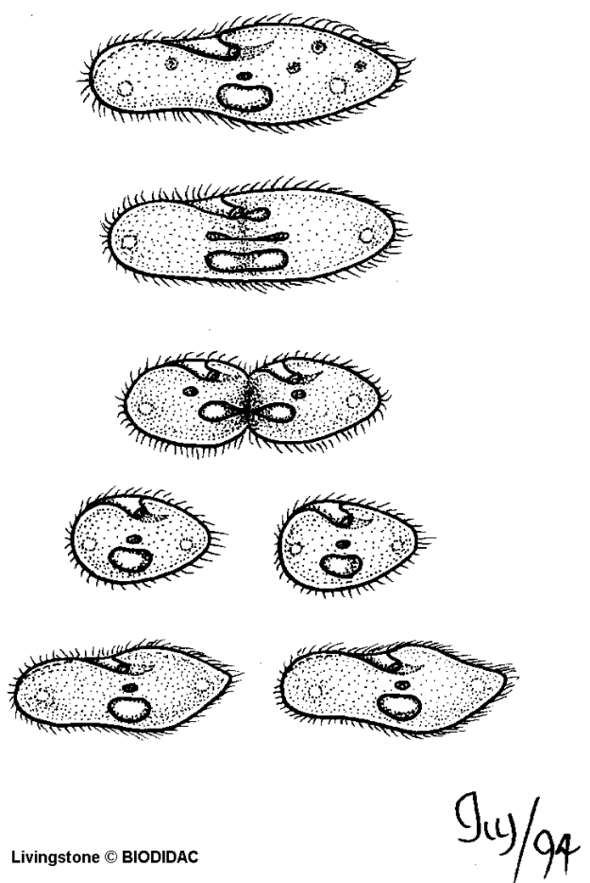
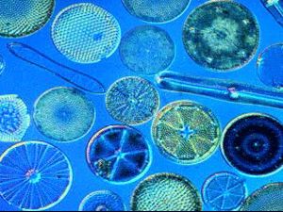
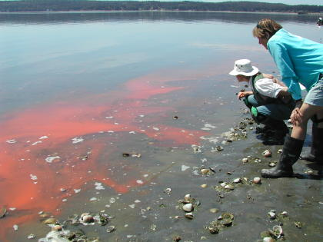
3. Reproduction: Asexual through binary fission (in animal-like protists) and fragmentation (in plant-like protists). Some may exchange DNA though conjugation (sexual).
4. Ecological/Economic Importance:
a. Plant-like protists (commonly called algae) are the primary producers of oxygen used for cellular respiration. They are also the producers that form the base of all aquatic food webs.

Slide 8
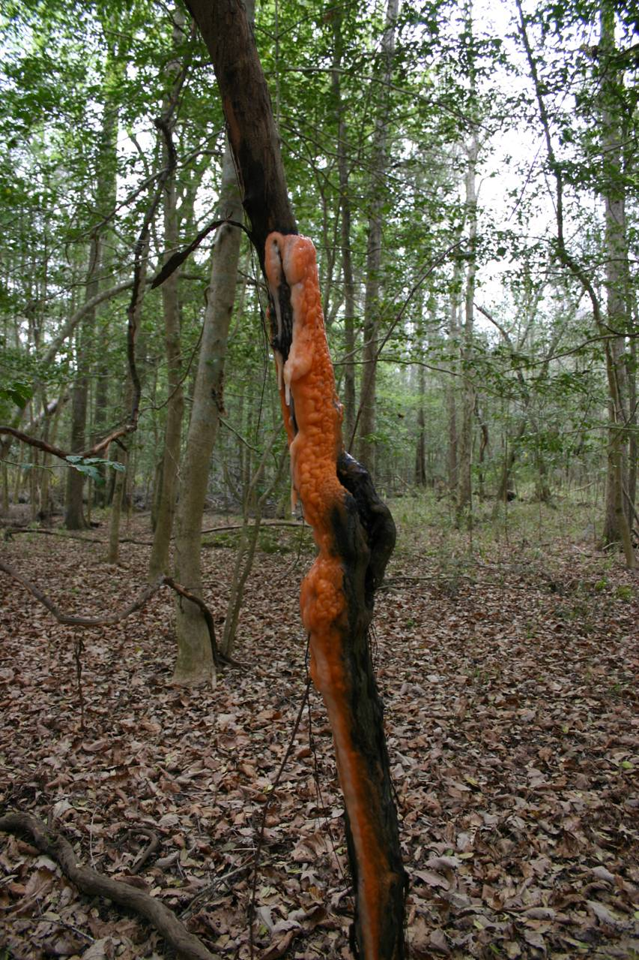
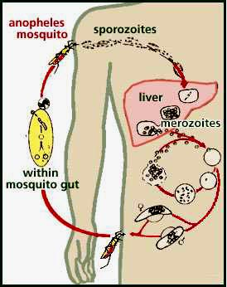
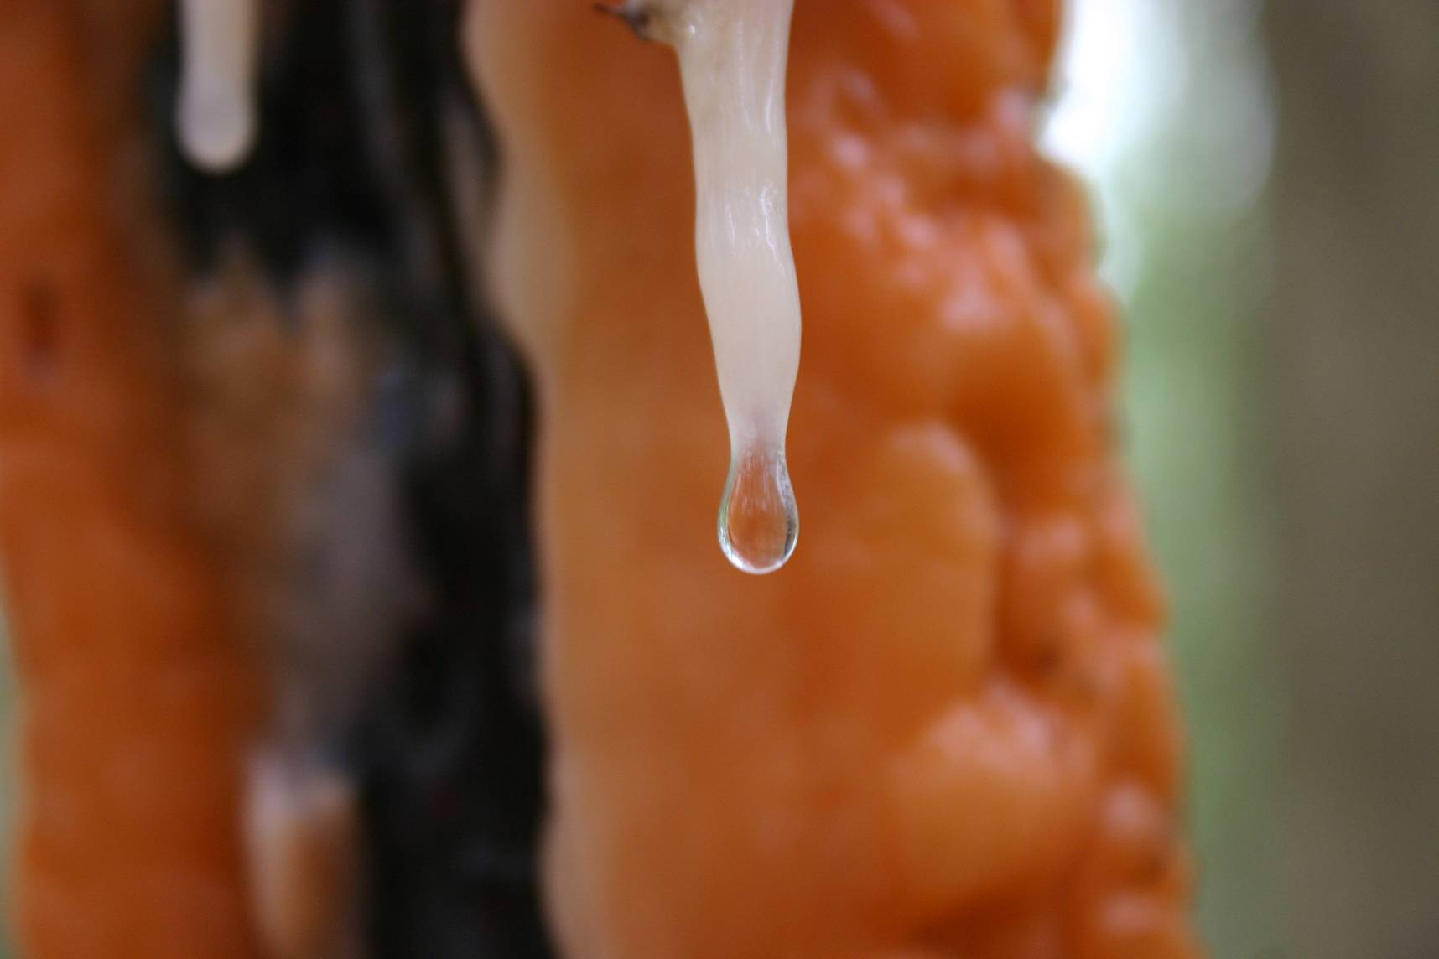
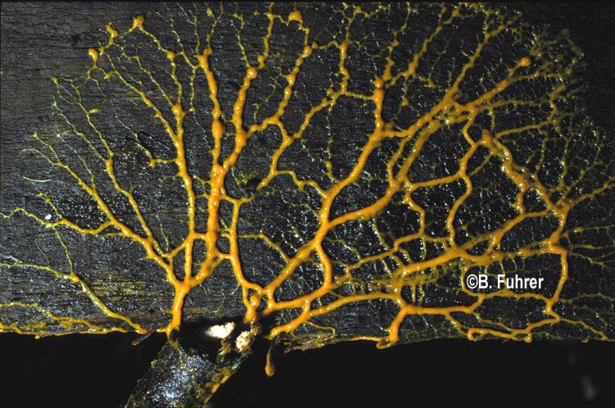
b. Animal-like protists (commonly called protozoans) are important primary consumers in aquatic food webs. Many protozoans also cause diseases such as malaria.
c. A specialized group of protists called slime molds are important decomposers.

Slide 9
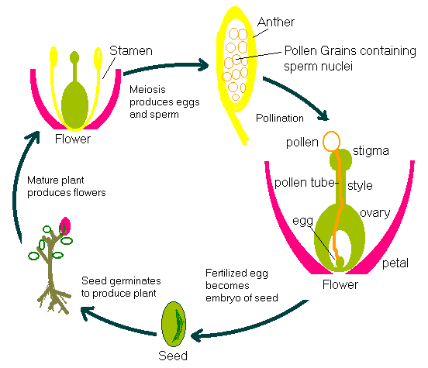
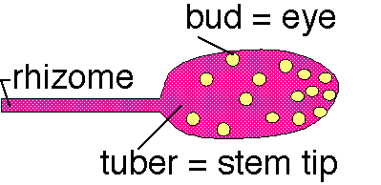
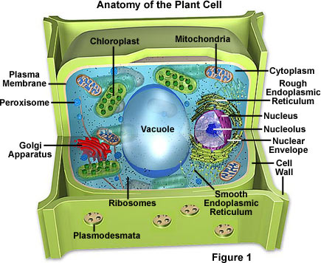
D. Kingdom Plantae
1. Cellular Structure: Eukaryotic with cell wall, all multicellular
2. Metabolism:
a. Food getting: All are photosynthetic (autotrophic).
b. Cellular energy: All utilize aerobic respiration for the production of ATP.
3. Reproduction: All reproduce sexually (using sperm and egg or spores); may reproduce asexually (using vegetative propagation or spores)
Each one of these buds can develop into a new plant next year. In fact a whole row of potato plants can be started from just one good tuber.

Slide 10
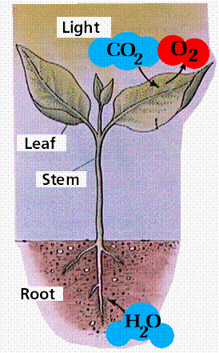
4. Ecological/Economic Importance: Plants are exponentially more complex as compared to algae, but perform many of the same ecological roles (oxygen production, base of food web). Plants are also used for numerous products such as clothing (cotton), paper, medicine (aspirin), and lumber.

Slide 11
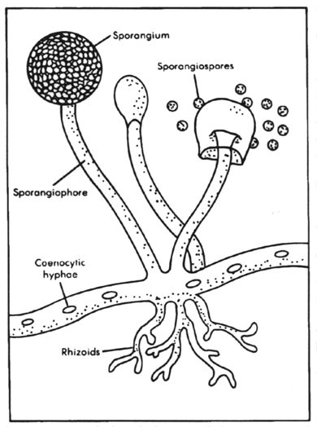
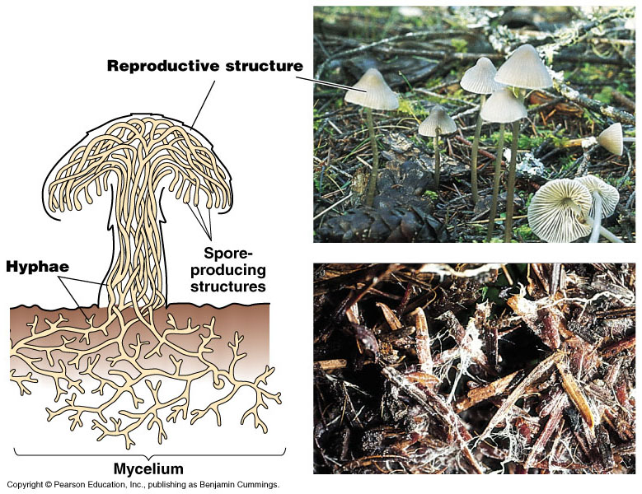
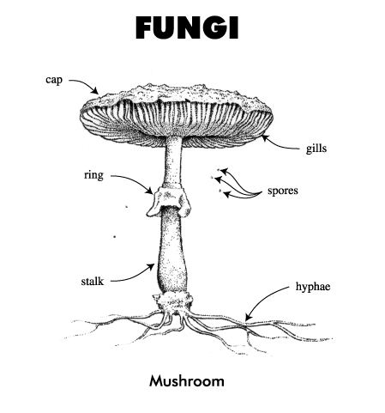
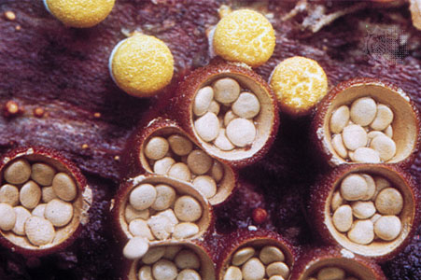
E. Kingdom Fungi
1. Cellular Structure: Eukaryotic with cell wall, mostly multicellular (mushroom) with some unicellular (yeast)
2. Metabolism:
a. Food getting: Heterotrophic with extracellular digestion (fungi secrete digestive enzymes and absorb nutrients across the cell wall)
b. Cellular energy: Some utilize aerobic respiration for the production of ATP (mushrooms), some are anaerobic (yeast).
Bird’s Nest Fungi

Slide 12
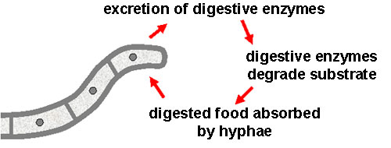
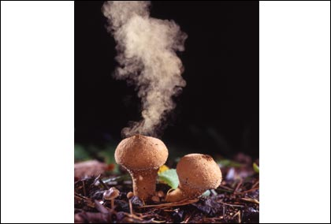
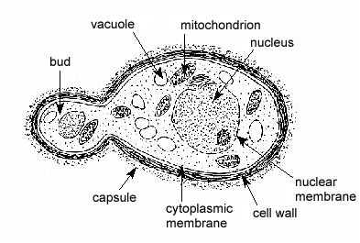
3. Reproduction: May be asexual (budding in yeast and spore production in other fungi), or sexual (spores).
4. Ecological/Economic Importance: Fungi are important decomposers. Fungi can be beneficial to humans (ex. used to make food and alcohol), or harmful (cause diseases such as ring worm and athletes foot)

Slide 13
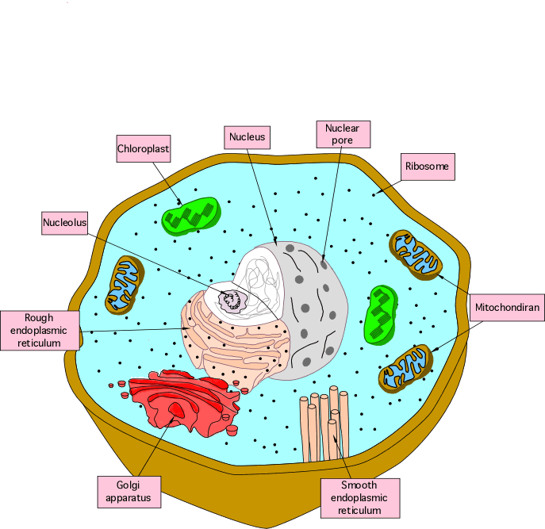
F. Kingdom Animalia
1. Cellular Structure: Eukaryotic with no cell wall, all are multicellular
2. Metabolism:
a. Food getting: All are heterotrophic and have diverse methods for acquiring food.
b. Cellular energy: All utilize aerobic respiration for the production of ATP but some specialized cells can convert to anaerobic respiration when oxygen is scarce

Slide 14
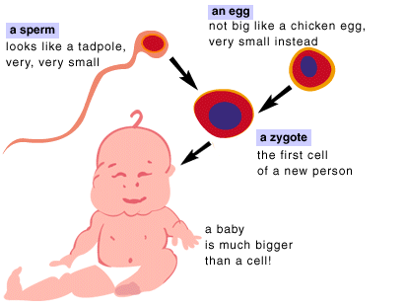
3. Reproduction: All animals reproduce sexually (egg and sperm), but some simple animals may also reproduce asexually (fragmentation in sponges, regeneration in worms)
4. Ecological/Economic Importance: Animals are important consumers in food webs. Animals may be beneficial to humans (ex. foods) or harmful (ex. worms may cause disease)

Slide 15
The 6 Kingdoms
Name | Cell type | Body form | Food-getting | Reproduction | Example
Bacteria | Prokaryotic | Unicellular | Autotrophic or Heterotrophic | Asexual – binary fission; “Sexual” - conjugation | bacteria
Archae | Prokaryotic | Unicellular | Autotrophic or Heterotrophic | Asexual – binary fission; “Sexual” - conjugation | Extreme Bacteria
Protista | Eukaryotic | Unicellular or Multicellular | Autotrophic or Heterotrophic | Asexual – budding, binary fission, fragmentation; “Sexual” - conjugation | Algae Protozoa Slime mold
Plantae | Eukaryotic | Multicellular | Autotrophic | Asexual – vegetative propagation, spores Sexual - seeds | Moss Fern Oak tree
Fungi | Eukaryotic | Unicellular or Multicellular | Heterotrophic | Asexual – budding, spores | Yeast Mushroom
Animalia | Eukaryotic | Multicellular | Heterotrophic | Asexual – regeneration Sexual | Sponge Worm Fish Bird Mammal

Slide 16
Exit Ticket
Socrative.com
QPLFCPSNG

