Slide 1
Do Now
Can living things come from non-living things?
What is evolution?
What is a heterotroph?

Slide 2
Biogenesis
Life from living things
Abiogenesis
life from non-living things – spontaneous generation

Slide 3
EXAMPLE
Believed that fish came from mud
Aristotle

Slide 4
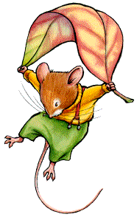
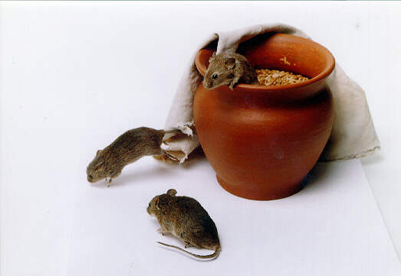
Recipe for Mice
1. Get a Box
2. Add some old shirts
3. Put in some rice
4. Place in a dark cellar
5. After 21 days, you’ll have mice
By: Anton von Helmont
http://www.youtube.com/watch?v=WNByRghR6sw

Slide 5
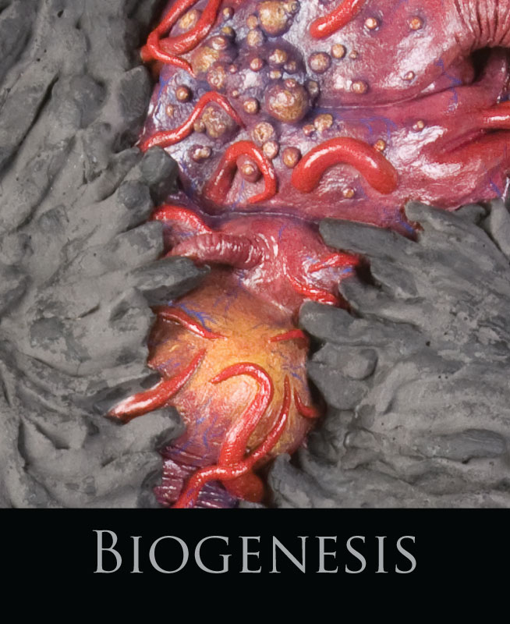
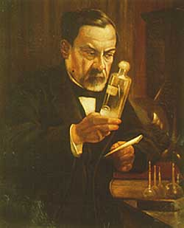
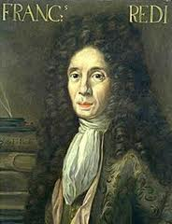
Who disproved spontaneous generation and how?

Slide 6
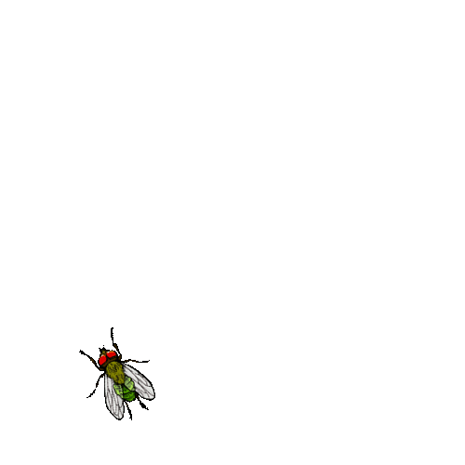
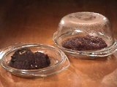
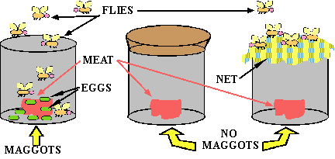
Francisco Redi
In 1668, used flies and meat in his experiment to show that flies did not come from meat but from maggots (baby flies)

Slide 7
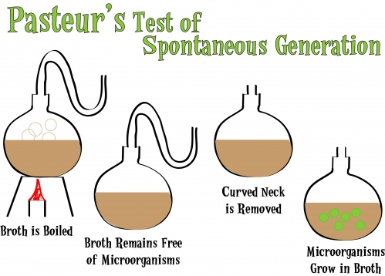
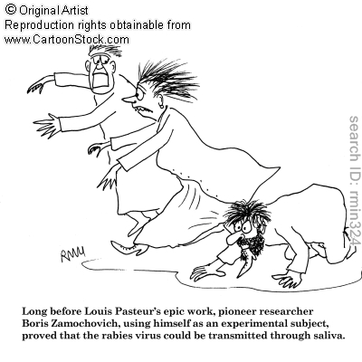
Louis Pasteur
Disproved spontaneous generation once and for all
Filled S-shaped flasks with broth.
Boiled the broth to kill any microorganisms already in the broth and in the air
Found no Life after 1 year

Slide 8
Animation
http://www.sumanasinc.com/webcontent/animations/content/scientificmethod.html

Slide 9
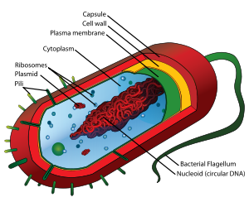
The Heterotroph Hypothesis
Early earth organisms:
  Prokaryotic (simple organisms)
  Anaerobic (no oxygen in atmosphere)
  Heterotrophs (take in nutrients)

Slide 10
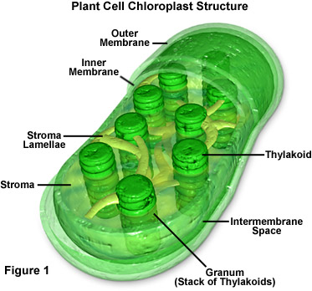
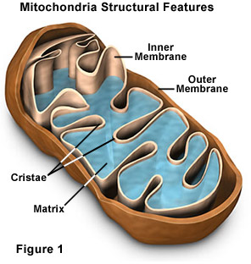
The Heterotroph Hypothesis
Once oxygen production occurred, aerobic prokaryotes developed
Large heterotrophic cells consumed small cells as food
Endosymbiont hypothesis → symbiotic relationship between large and small cells developed
  Small cells became mitochondria and chloroplasts with their own DNA

Slide 11
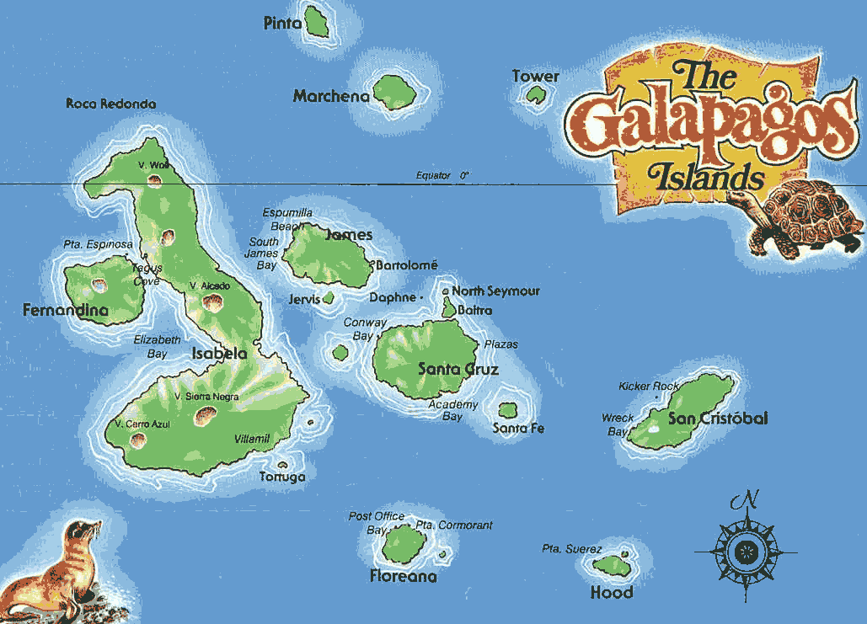
Natural Selection
Charles Darwin – traveled to Galapagos Islands
Proposed that new species could develop by natural selection

Slide 12
Natural Selection
Process:
  Variation of traits leads to different phenotypes
  Overproduction in populations leads to competition for resources
  Natural Selection favors the best suited phenotype at the time
  Survival of the best adapted (fittest) leads to higher reproductive success

Slide 13
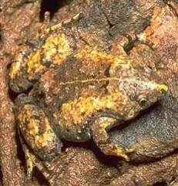
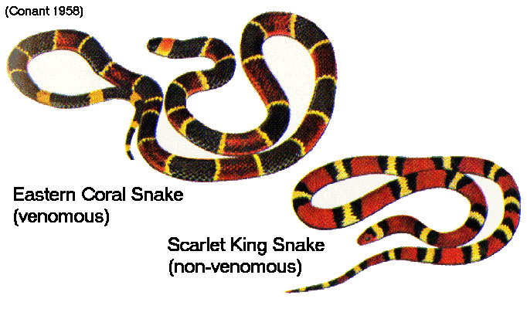
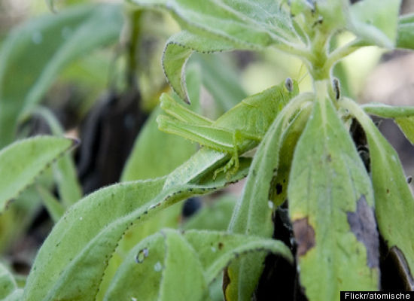
Adaptations
Any heritable trait that suits an organism to its natural function in the environment (niche)
Structural adaptations
  Mimicry and camouflage
Behavioral adaptations
  Herding, schooling, growling
Physiological Adaptations
  Enzymes, sight, oxygen-binding of hemoglobin
  http://www.youtube.com/watch?v=EJGtN-igCu8 mimicry

Slide 14
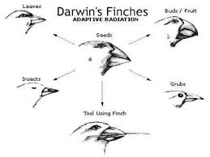
Mechanisms of Evolution
Individuals don’t evolve; populations do.
The population is the smallest unit of evolution because acquired traits in an individual cannot be passed on (inherited by offspring).
However, different traits already present in a population can be “selected”, changing the population.

Slide 15
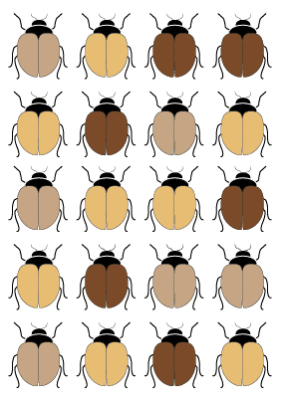
Mechanisms of Evolution
Evolution occurs when the gene pool (all of the genes of a population) changes. A change in genotype may lead to a change in phenotype. Evolution acts on the phenotype.

Slide 16
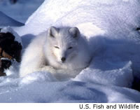
Mechanisms of Evolution
Mutations are random changes in DNA and may lead to a new phenotype. Mutations provide the raw material for evolution – diversity. For example, a mutation causing white fur in Arctic foxes may lead to better camouflage in winter.

Slide 17
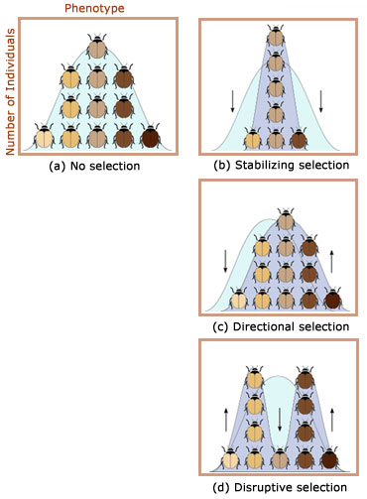
Selection
The environment also plays a key role in evolution. Environmental changes are natures “selection forces” that act upon the phenotype ranges caused by genes. There are three basic patterns by which natural selection occurs:
i. Stabilizing selection favors the “average” phenotype in a population.
ii. Directional selection favors ONE of the extreme ends of the “typical” distribution.
iii. Disruptive Selection favors BOTH of the extreme ends of the “typical” distribution.

Slide 18
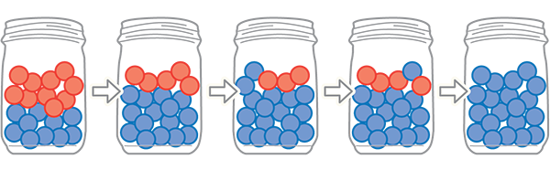
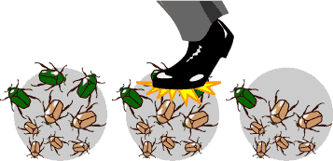
Genetic Drift
Affects the genetic makeup of the population
Random
Does not produce adaptations
Most often occurs in small populations

Slide 19
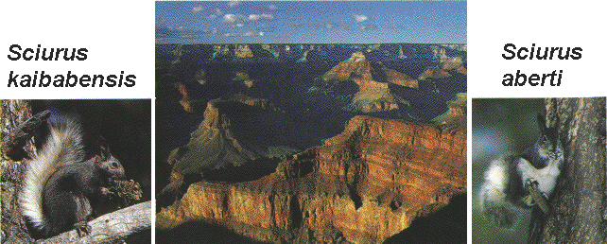
Speciation is the development of a new species.
A species is defined as a group of organisms that can produce fertile offspring.
Speciation occurs when a population is separated, usually due to a geographical barrier, and natural selection changes the population so much the two groups could no longer interbreed. Therefore, geographic isolation leads to reproductive isolation.

Slide 20
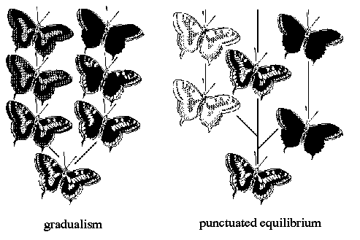
Timeframes of evolution differ based on the environment and the population. The fossil record provides evidence for two rates of speciation:
1. Gradualism describes speciation that occurs over a long period of time due to the accumulation of small changes.
2. Punctuated equilibrium describes speciation that occurs in rapid bursts that may be separated by 1000’s of years of stability. The primary stimulus is environmental change. (ex: mutation)

Slide 21
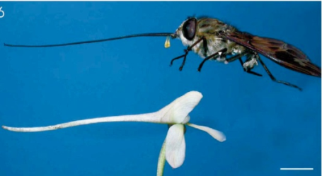
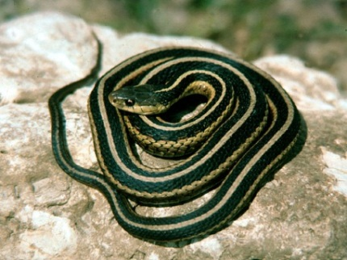
Co-Evolution: The evolution of one species influences the evolution of the other species.
Example: A moth and a flower. They evolve together so the moth’s tongue is exactly the right shape to fit in the flower and eat the nectar, while pollinating the flower.
Example: Garter snake and a rough-skinned newt: The snake eats the newt and the newt has developed chemicals to poison the snakes. Some snakes developed a mutation to be resistant to the poison so they can still eat the newt

Slide 22
http://www.youtube.com/watch?v=0SCjhI86grU stated clearly natural selection (9 min)
http://www.youtube.com/watch?v=GhHOjC4oxh8 stated clearly evolution (8 min)

Slide 23
Artificial vs natural selection
http://learn.genetics.utah.edu/content/selection/artificial/
https://www.youtube.com/watch?v=IDN-QeVhQTc super cow – only watch 1st couple of minutes

Slide 24
Video Clips
https://www.youtube.com/watch?v=Nmkj5gq1cQU&feature=related
http://science.discovery.com/videos/100-greatest-discoveries-shorts-natural-selection.html Bill Nye
http://www.youtube.com/watch?v=8yvEDqrc3XE speciation

Slide 25
Exit Ticket
Socrative.com
QPLFCPSNG

