Slide 1
Do Now
1. Which will most likely cause variations to occur within a species?
A. competition B. mutation
C. mutualism D. predation
2. In which populations does genetic drift most often occur?
A. in small populations B. in large populations
C. in marine populations D. in terrestrial populations
3. Natural selection is described as “survival of the fittest.” Organisms considered fit will survive to accomplish which?
A. migrate to other areas B. reproduce and pass on genes C. have a larger territory D. have more genetic mutations
4. Which fact provides the best evidence for the theory that mitochondria and chloroplasts evolved from free-living cells?
A. Mitochondria and chloroplasts are about the same size as bacteria.
B. Mitochondria and chloroplasts carry their own DNA.
C. Mitochondria and chloroplasts perform the same function.
D. Mitochondria and chloroplasts look like bacteria.
5. Which best describes the first unicellular organisms on Earth?
A. aerobic and eukaryotic B. aerobic and prokaryotic
C. anaerobic and eukaryotic D. anaerobic and prokaryotic

Slide 2
Evidence for Evolution

Slide 3
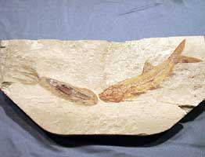
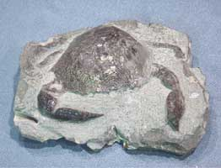
Fossil Evidence
Fossil evidence provides an incomplete record of early life.
Fossils can include any evidence of life, such as imprints and remains of organisms.
This evidence must be interpreted to form an overall picture of how species have changed over time (evolved).
Fossils must be dated to help establish a time frame for the existence of a species.
There are two methods of determining the age of fossils.

Slide 4
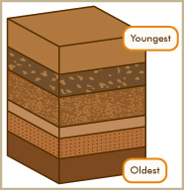
Relative Dating
In relative dating the exact age of the fossil cannot be determined, only the order of appearance as compared to other fossils found in nearby rocks.
Fossils occur in layers of sedimentary rock.
The fossils near the top will be more recent than fossils in lower layers of rock.

Slide 5
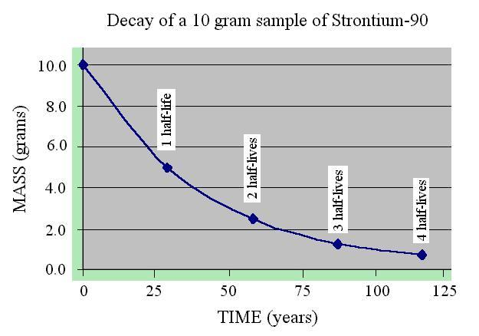
Radioactive Dating
Radioactive dating gives a more exact age using the natural decay of radioactive isotopes in organisms.

Slide 6
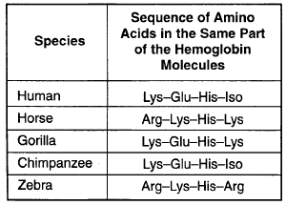
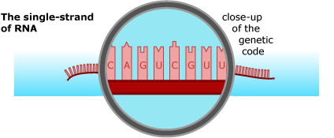
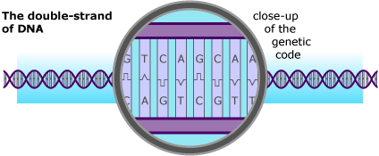
Biochemical Evidence
Biochemical similarities include comparisons of DNA and the resulting amino acid sequences for certain, shared proteins.
This is considered one of the most reliable and objective types of evidence used to determine evolutionary relationships.
In general, the fewer differences found between two species, the closer the evolutionary relationship.

Slide 7
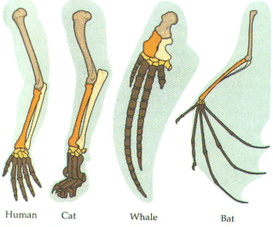
Anatomical Evidence
Shared anatomical structures supports some type of evolutionary relationship.
Structures with a similar bone arrangement are called homologous structures. A similar bone arrangement, even if the functions are different, supports evolution from a common ancestor.

Slide 8
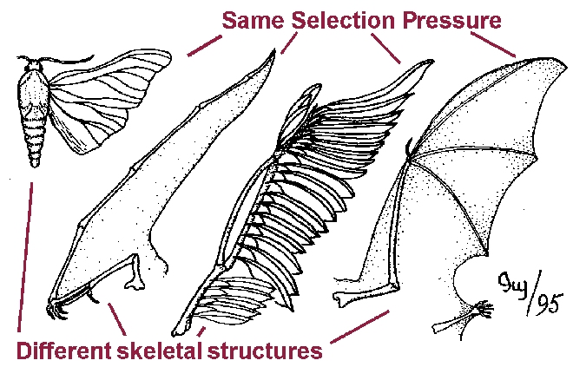
Anatomical Evidence
Structures that perform the same function (ex. flying) but are very different anatomically (ex. bird wing vs. butterfly wing) are called analogous structures. This supports evolution in similar habitats though not from a recent common ancestor.

Slide 9
Anatomical Evidence
Vestigial structures (ex. appendix or tail bone in human) are not functional in that organism, but may represent a link to a previous ancestor.

Slide 10
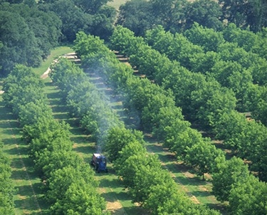
Pesticide Resistance
Farmers use pesticides to eliminate insects.
In a population of insects, some individuals will possess genetic immunity to certain chemicals.
When the chemicals are applied, the individuals with genetic immunity will survive and reproduce, passing this resistance to the next generation of offspring.
Over time, more individuals are born with this immunity, rendering the pesticide useless.

Slide 11
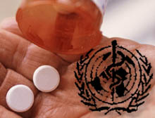
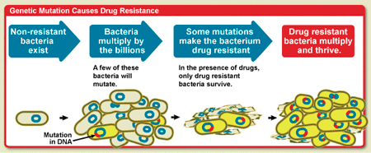
Antibiotic Resistance
Antibiotics are drugs that fight bacterial infections.
Within any population there is genetic variation.
In the case of antibiotic resistance, some bacteria are genetically more resistant to the antibiotic than other bacteria.

Slide 12
Antibiotic Resistance
If the amount of antibiotic delivered is too low or the full course not completed, only those least resistant will die.
The surviving, resistant bacteria will reproduce.
With future applications of antibiotics the population is selected to become more and more resistant.
The overuse of antibiotics has led to many resistant strains of bacteria.

Slide 13
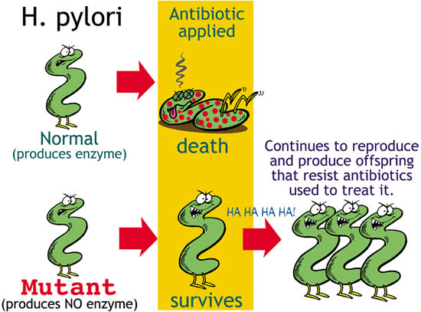

Slide 14
http://www.youtube.com/watch?v=zjR6L38yReE (5 min)
http://www.youtube.com/watch?v=D_yEP91z8Vk new
http://www.brainpop.com/science/ecologyandbehavior/antibioticresistance/preview.weml brain pop

Slide 15
Exit Ticket
Socrative.com
QPLFCPSNG

