Slide 1
Do Now
1) What is weather?
2) If you could travel anywhere in the world, where would you go? Where is this place (i.e. northwestern hemisphere, near the South Pole, etc.). Is it in the mountains, close to water, or in a desert? What’s the climate like there?

Slide 2
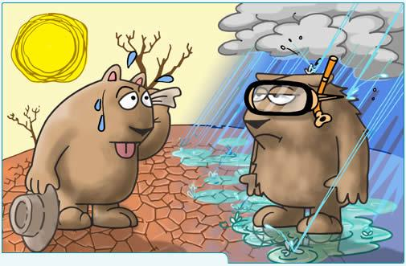
Climate

Slide 3
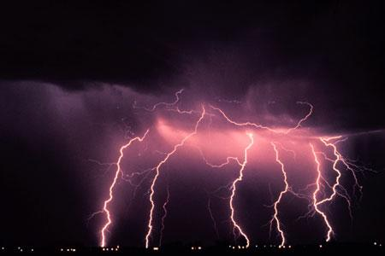
Weather
Weather- what is happening in the atmosphere in particular place at a particular time.

Slide 4
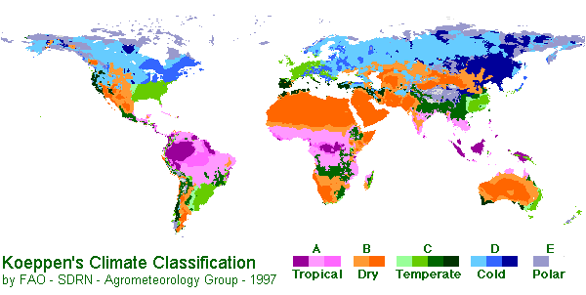
Climate- the average weather for an area over a long period of time.

Slide 5
What Factors Determine Climate?
Latitude
Atmospheric circulation patterns
Oceanic circulation patterns
Local geography
Solar activity
Volcanic activity
***Most important of these factors is distance from the equator (Latitude).

Slide 6
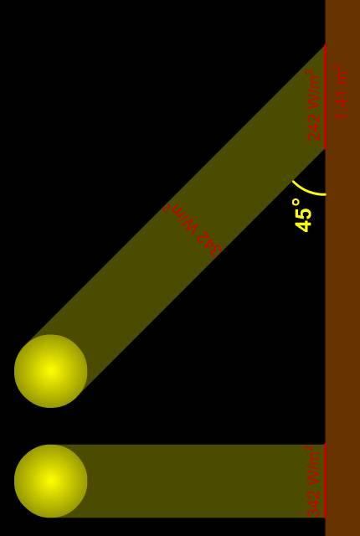
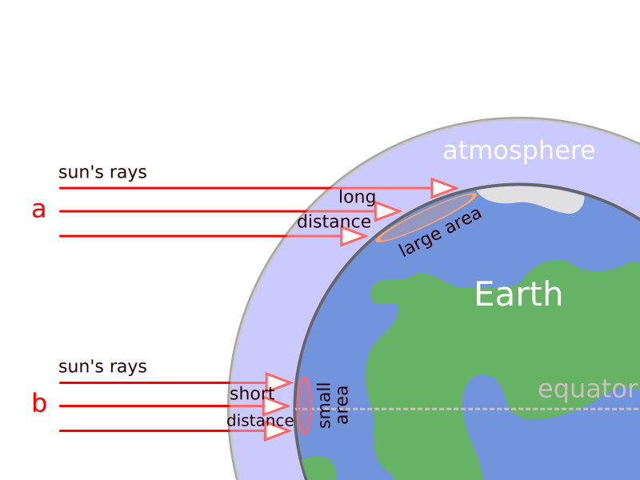
Differential Heating
At the equator, sunlight hits the Earth vertically and is concentrated over a smaller surface area.
Away from the equator, sunlight hits the Earth at an oblique angle and spreads over a larger surface area.

Slide 7
Air Masses
Air Masses and Weather
◆ Air Masses
An air mass is an immense body of air that is characterized by similar temperatures and amounts of moisture at any given altitude.ir Masses
◆ Movement of Air Massesement of Air Masses
• As it moves, the characteristics of an air mass change and so
As it moves, the characteristics of an air mass change and so does the weather in the area over which the air mass moves.
s the weather in the area over which the air mass moves.

Slide 8
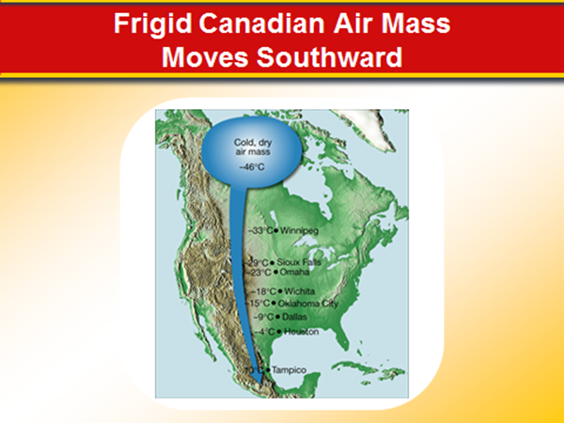

Slide 9
What a Mass
Tropical Air Masses are Warm and Wet
Polar Air Masses are Cold and Dry

Slide 10
Air Masses are classified according to the surface over which they form.
Continental = formed over land
Maritime = formed over water

Slide 11
21.1 Factors That Affect Climate
Factors That Affect Climate
◆ Latitude
• As latitude increases, the intensity of solar energy decreases.
• The tropical zone is between 23.5º north (the tropic of Cancer) and 23.5º south (the tropic of Capricorn) of the equator. The sun’s rays are most intense and the temperatures are always warm.
• The temperate zones are between 23.5º and 66.5º north and between 23.5º and 66.5º south of the equator. The sun’s rays strike Earth at a smaller angle than near the equator.

Slide 12
21.1 Factors That Affect Climate
Factors That Affect Climate
◆ Latitude
• Polar zones are between 66.5º north and south latitudes and the poles. The sun’s rays strike Earth at a very small angle in the polar zones.
◆ Elevation
• The higher the elevation is, the colder the climate.
◆ Topography
• Topographic features such as mountains play an important role in the amount of precipitation that falls over an area.

Slide 13
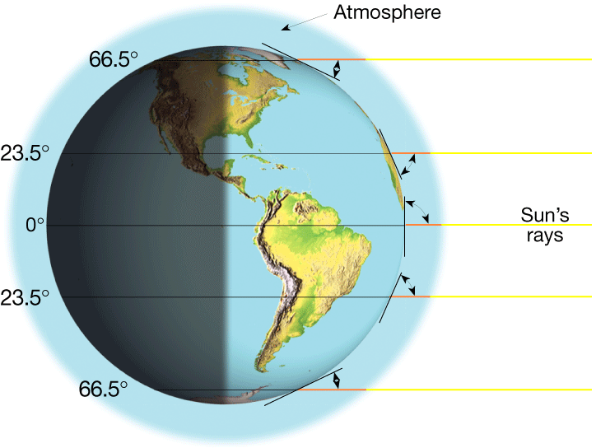
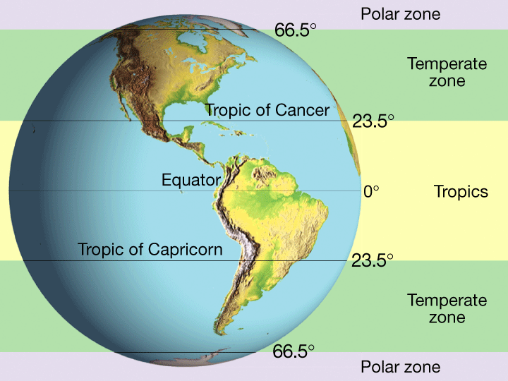
Earth’s Major Climate Zones
Notes:
Makes no sense without caption in book

Slide 14
21.2 World Climates
The Köppen Climate Classification System
◆ The Köppen climate classification system uses mean monthly and annual values of temperature and precipitation to classify climates.

Slide 15
Tropical Zone AKA: Humid Tropical Climate Mean temperature above 18C and can exceed 200 cm of rain
Wet Tropical
High temperature and a lot of rain
Example: tropical rain forest
Tropical Wet and Dry
Similar to “Wet Tropical” but periods of low rain fall
Example: Savannas (tropical grasslands)

Slide 16
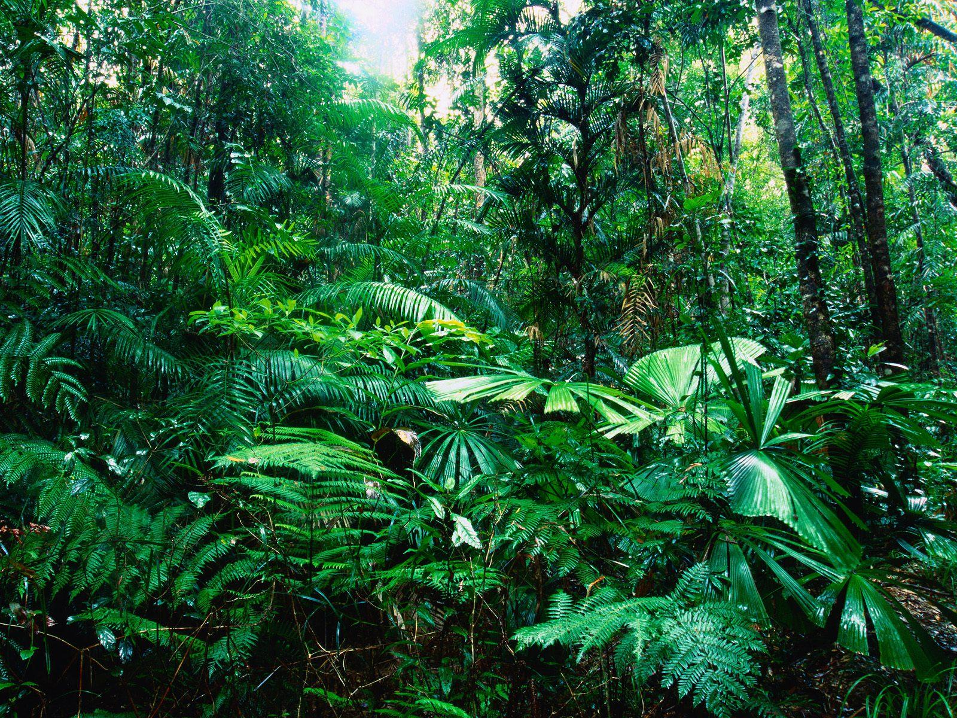
Tropical Rain Forest

Slide 17
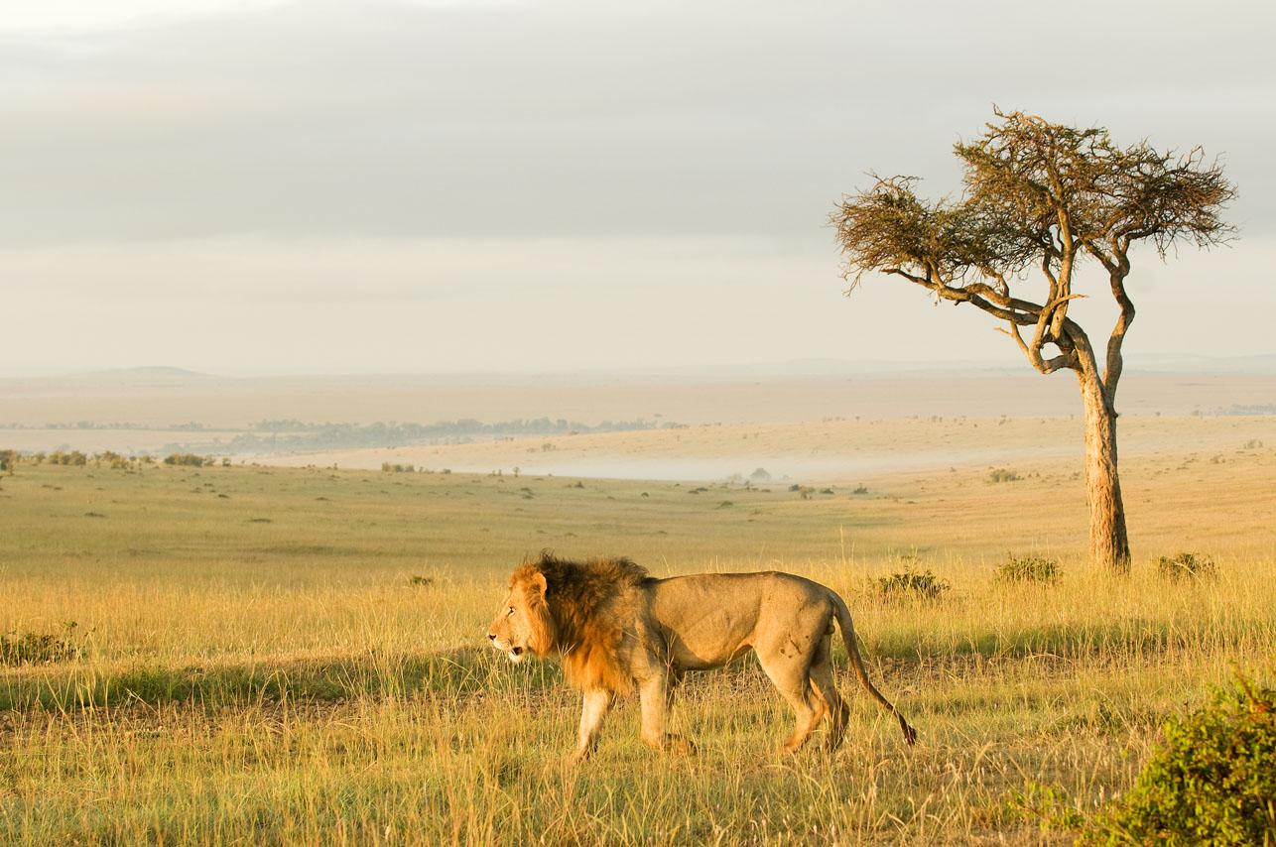
Savannah

Slide 18
Temperate Zone AKA: Humid Mid-Latitude Climate
Humid Mid-Latitude with Mild Winters
South Eastern United States
(hot summer, mild winter)
Humid Mid-Latitude with Severe Winters
Western Alaska to Newfoundland in North America
(mild summer, cold winter)

Slide 19
Polar Zone
The mean temperature of the warmest month is below 10C
Little Precipitation
Example: tundra and ice cap

Slide 20
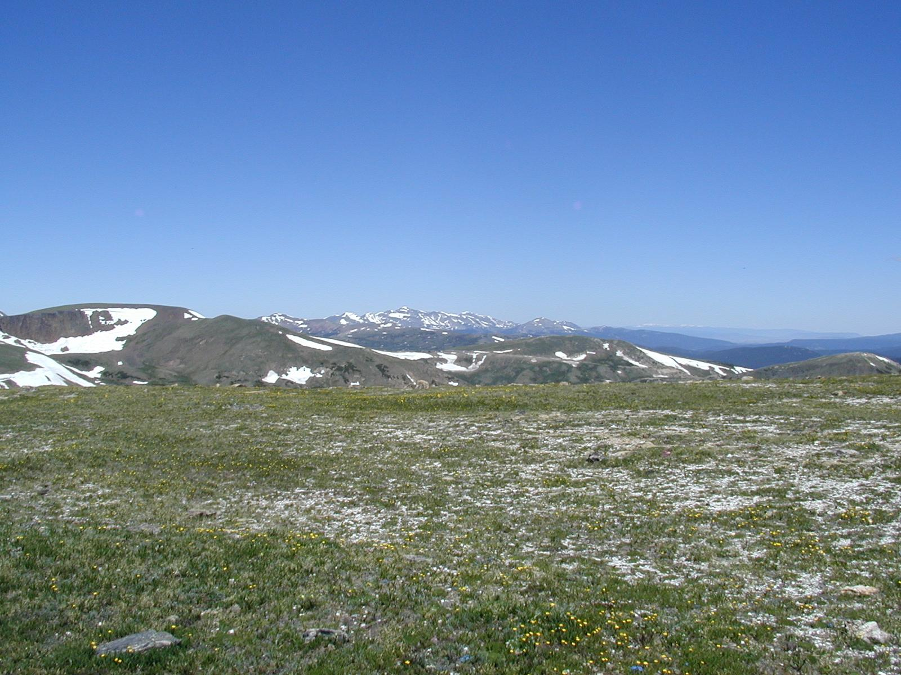
Tundra

Slide 21
Brochure
Make a brochure/ pamphlet either individually or with a partner
Your brochure needs to explain:
What climate is
What climate change is
What causes climate change
Make sure you include pictures and
diagrams!

Slide 22
Exit Ticket
Socrative.com
QPLFCPSNG

